Slide 1
Object Detection
Title

Slide 2
Object Detection Task
Object detection is a computer vision technique that allows us to identify and locate objects in an image or video. Some common use cases are:-
Retail: Customer Behavior Tracking
Agriculture: Detection of Wheat Rust
Public Health: Image Segmentation of Scans
Automotive Industry: Object Recognition and Classification in Traffic
Fitness: Human Pose Estimation

Slide 3
Object Detection Algorithms
Region Classification: Models that use this approach, identify object location from a set of possible regions, they then crop them and classify them. Eg: RCNN, Faster RCNN.
Anchor Boxes: Predefined Anchor Boxes are passed over an image to locate objects. Eg: YOLO
Keypoint Estimation: Identify key points in image and use that to locate objects. Eg: CornerNet, CentreNet

Slide 4
CentreNet
Object as Points.

Slide 5
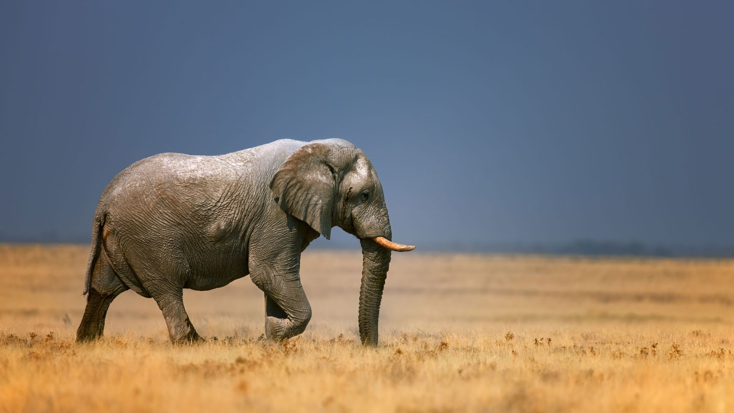
The Idea behind CentreNet
CentreNet aims at finding the centre of objects along with their heights and widths, which can then be used to generate a bounding box around the object. This is done by building a model that takes an input image and outputs heatmaps. There are heatmaps to indicate
Centre of objects
Height of objects
Width of objects
Height Offset
Width Offset
CentreNet
C : Number of object types
Total Number of Heatmaps: C + 4

Slide 6
Preparing Input Data
The input data for centreNet requires images and data regarding the centre, height and width of various objects in the image (often stored in a csv file). Steps the prepare the data for the model is as follows:
Downscale the image by some constant
Prepare separate heatmaps for each class, with the centre of objects highlighted in their respective heatmap.
Create 4 more heatmaps, for the sizes and offsets. At the coordinates of the centre of objects store the value of size and offset.
‘R’
X | Y | Height | Width | Class
20 | 100 | 200 | 350 | Elephant

Slide 7

Preparing Input Data
Splat all key points with Gaussian Kernel
Downscale by R
Create Heatmap

Slide 8
Preparing Input Data
200/4 = 50
350/4 = 87.5 -> 87
Height Size Heatmap (R=4)
Width Size Heatmap (R=4)
200 - 4*50 = 0
350 - 4*87 = 2
Height Offset Heatmap (R=4)
Width Offset Heatmap (R=4)

Slide 9
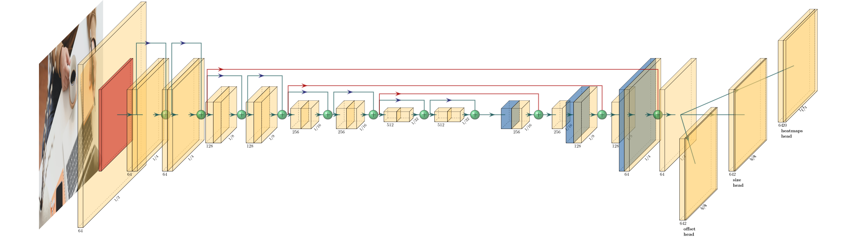
Model
Source: https://towardsdatascience.com/new-approaches-to-object-detection-f5cbc925e00e

Slide 10
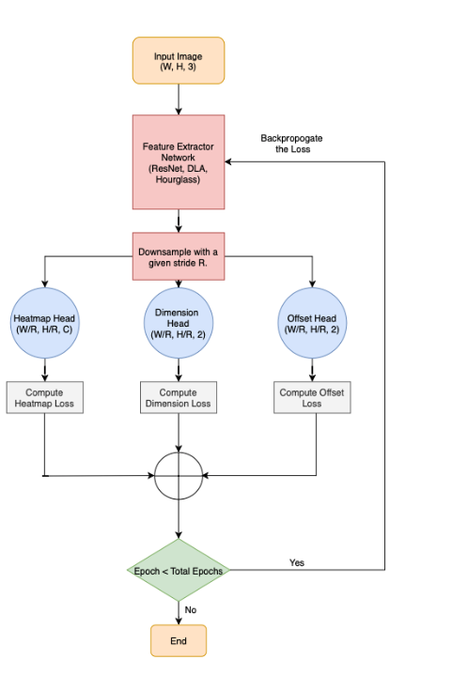
Model
The model consists of an encoder-decoder network (EfficientNet, ResNet or any other), which is then used to obtain three heads.
Heatmaps Head: This outputs the heat maps for all the object types. It has a shape of (H/R, W/R, C).
Size Head: This head contains the size value stored at the centre of each object. It has a shape of (H/R, W/R, 2).
Offset Head: This head contains the offset value stored at the centre of each object. It has a shape of (H/R, W/R, 2).

Slide 11

Loss
The are three losses to account for
Heatmap Variant Focal Loss
L1 Norm Offset Loss
L1 Norm Dimension size Loss
Putting it all together

Slide 12
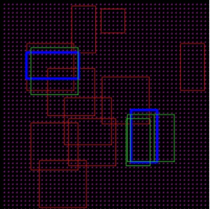

Loss function for the Heatmap
Lets consider using Cross-Entropy Loss
This is a result of a what is known as a Class Imbalance Problem
Blue: Ground truth Boxes, Red: Incorrect Predictions and Green: Correct predictions

Slide 13
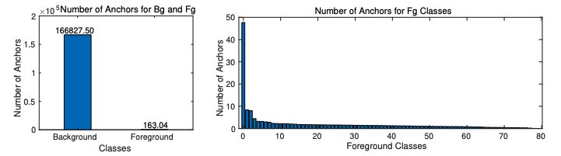
Class Imbalance Problem
This is observed when one class is over represented in the dataset.
There are two possible imbalances:
More data of background compared to Foreground
One of the classes occurs more frequently than the others

Slide 14




Focal Loss
All incorrectly predicted cases are given more importance than correctly predicted cases and this helps take care of the class imbalance problem
To account for class imbalance problem we have to modify Cross-Entropy Loss
Let us introduce a variable, that is αwhen there is an object in anchor box and 1 - α when only the background is present

Slide 15

Focal Loss
To account for the imbalance between foreground classes, we introduce another term
For Example: Say we want to detect three objects (cat, dog and rabbit)
(1) If y = 1, Object is a cat and the prediction is a cat
pt will be close to 1
1 - pt will be close to 0
FL will be close to 0

Slide 16

Focal Loss
(2) If y = 1, Object is a cat and the prediction is not a cat
pt will be close to 0
1 - pt will be close to 1
FL will be non-zero and significant value
Putting it all together
αand ˠ are hyperparameters

Slide 17
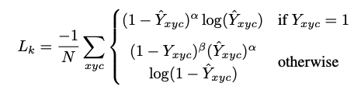
Heatmap Variant Focal Loss
Intuition: All incorrectly predicted cases are given more importance than correctly predicted cases and this helps take care of the class imbalance problem

Slide 18

L1 Norm Offset Loss
Predicted Offset value
Ground Truth Offset value
Intuition: We simply find the mean difference between predicted and ground truth offset values.

Slide 19

L1 Norm Dimension Size Loss
Predicted Dimensions
Ground Truth Dimensions
Intuition: We simply find the mean difference between predicted and ground truth dimensions for regression of width and height of bounding box

Slide 20
Total Loss
Putting it all together

Slide 21
Drawing Bounding Box
Coordinates | (X,Y)
Size Value | (W,H)
Offset Value | (∂X,∂Y)
Total | (X + ∂X - (W/2), Y + ∂Y - (H/2)) (X + ∂X + (W/2), Y + ∂Y + (H/2))

Slide 22
Summing it all up
1.Run the image through a feature Extractor
2.Downsample Image
3.Compute Heatmap Head, Dimension Head, Offset Head
4.Compute loss for each head
5.Backpropogate the loss

Slide 23
Questions?

